Slide 1
Image Segmentation

Slide 2
Image segmentation is partitioning or subdividing an image into its constituent regions or objects.
Level of detail to which the subdivision is carried depends on the problem being solved.
Should stop when objects or regions of interest have been detected.
Example, in automated inspection of electronic assemblies, interest lie in presence or absence of missing components or broken connection paths.
Segmentation is most difficult in applications like autonomous target acquisition , where the image processing system designer has no control over the operating environment.
For such environments, the best approach is to focus on selecting the types of sensors most likely to enhance the objects of interest.

Slide 3
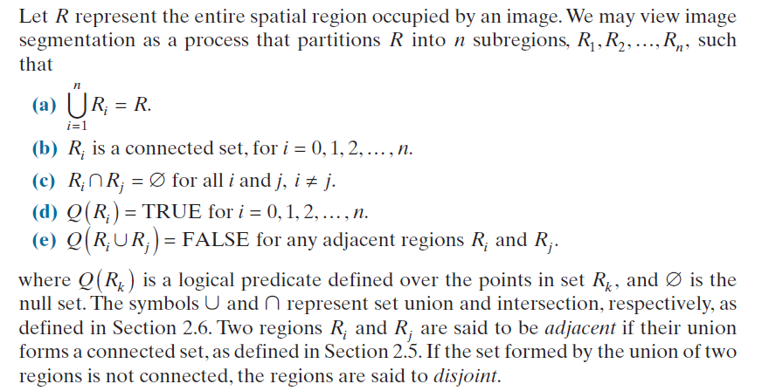
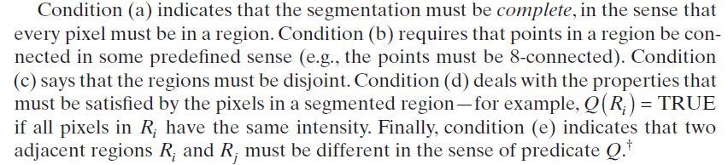

Slide 4
.
Most of the segmentation algorithms are based on
Discontinuity in intensity values
The approach is to partition an image based on abrupt changes in intensity, such as edges.
Boundaries or edges of regions are sufficiently different from each other and from the background.
Edge based segmentation is an example of this category.
Similarity in intensity values
The principal approach is based on partitioning an image in to regions that are similar according to a set of predefined criteria.
Thresholding, Region based segmentation (Region growing, Region splitting and merging ) are examples of methods in this category.

Slide 5
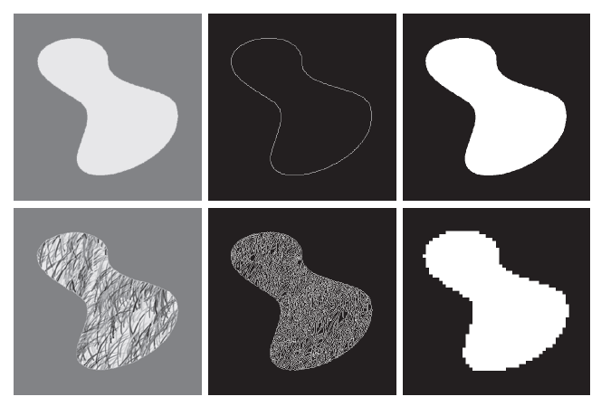
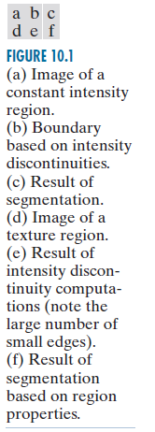
Figure 10.1(a) shows an image of a region of constant intensity superimposed on a darker background, also of constant intensity. These two regions comprise the overall image.
Figure 10.1(b) shows the result of computing the boundary of the inner region based on intensity discontinuities.
Points on the inside and outside of the boundary are black (zero) because there are no discontinuities in intensity in those regions.
To segment the image, we assign one level (say, white) to the pixels on or inside the boundary, and another level (e.g., black) to all points exterior to the boundary.
Figure 10.1(c) shows the result of such a procedure

Slide 6
The predicate used in figure (c) is:
“If a pixel is on, or inside the boundary, label it white: otherwise label it black”
Edge-based segmentation is not a suitable approach for figure(d)
However, we note that the outer region is constant, so all we need to solve this segmentation problem is a predicate that differentiates between textured and constant regions.
The predicate used in figure (f) is:
“Each subregion is labeled white if the standard deviation of its pixels in the subregion is positive and labeled black otherwise.”
Figure (f) shows the result of dividing the original image into subregions of size 4X4

Slide 7
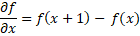
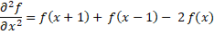
Background
Abrupt local changes in intensity can be detected using derivatives.
The first and second order derivative of a 1-d function f(x) is given as

Slide 8
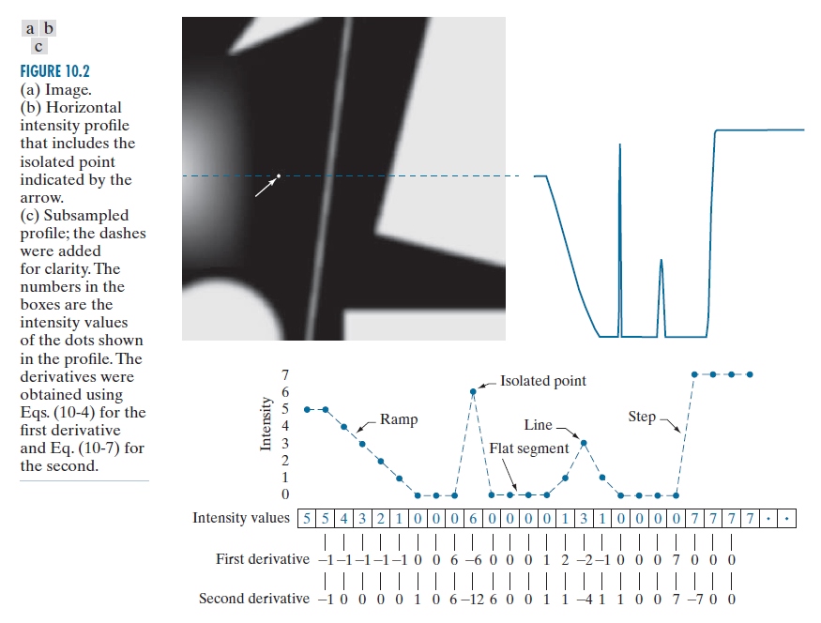
Background
The first derivative
Must be zero in areas of constant intensity
Must be nonzero at the onset of an intensity step or ramp
Must be nonzero along an intensity ramp.
The second derivative
Must be zero in areas of constant intensity
Must be non zero at the onset and end of an intensity step or ramp
Must be zero along an intensity ramp.

Slide 9
Background
We arrive at the following conclusions:
First order derivatives generally produce thicker edges
Second order derivatives have a stronger response to fine detail, such as thin lines, isolated points, and noise.
Second order derivatives produce a double edge response at ramp and step transitions in intensity.
The sign of the second derivative can be used to determine whether a transition in to an edge is from light to dark or dark to light.

Slide 10
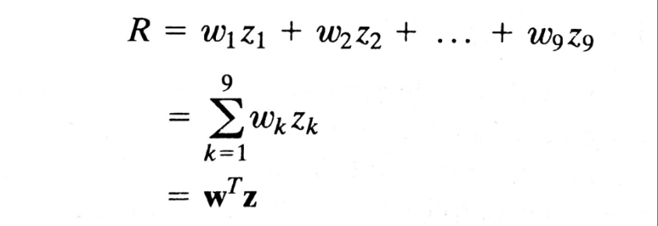
A spatial filter mask is used to compute first and second derivatives at every pixel location in an image.
For a 3x3 filter mask in the below figure, the procedure is to compute the sum of products of the mask coefficients with the intensity values in the region encompassed by the mask.
The response of the mask at the center point of the region is

Slide 11
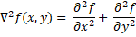
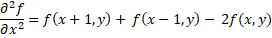
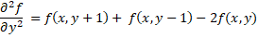
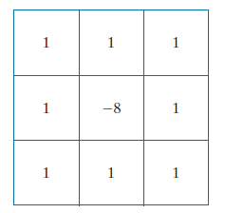
Isolated Points Detection
Point detection is based on second derivative, means using the Laplacian:
extending the above equation to include the diagonal terms, we get the filter as

Slide 12
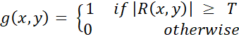
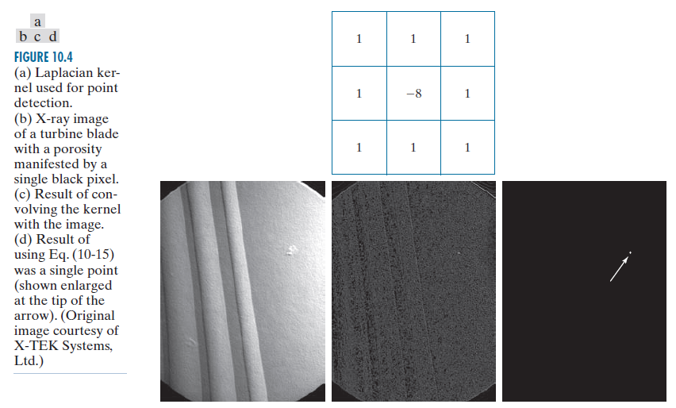
Isolated points detection
The above equation can be implemented using the filter mask called Laplacian mask as shown below.
The output is obtained using the following expression

Slide 13
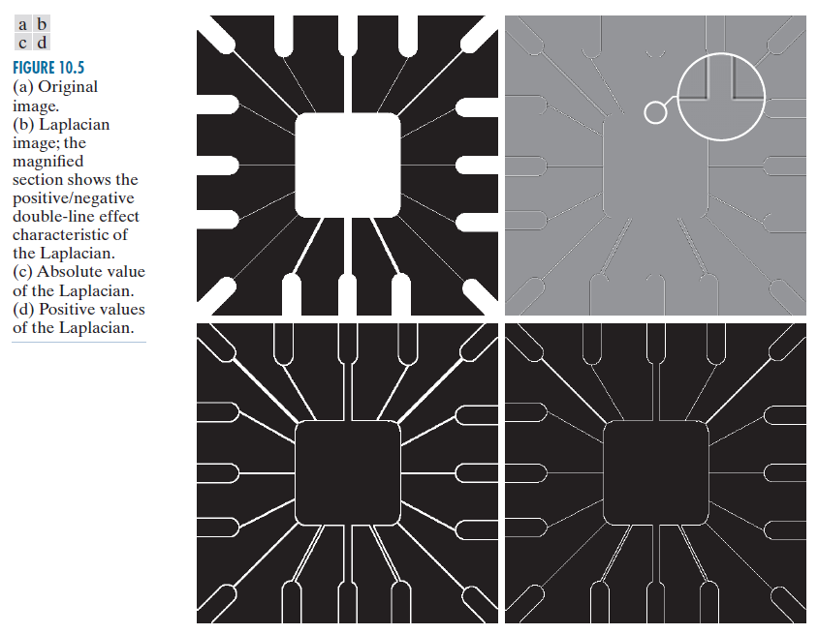
Line detection using Laplacian mask
Second derivative of an image give a stronger response and thinner lines than first derivative.
Thus we can use the Laplacian mask for line detection also.

Slide 14
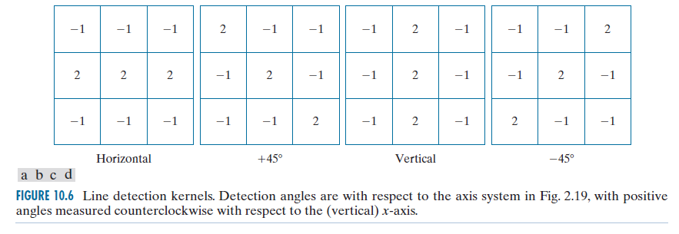
Detecting lines in specified directions
Some times we are interested in detecting lines in specified directions only.
The following masks are used for detecting horizontal, +45 degrees, vertical, and -45 degrees lines.

Slide 15
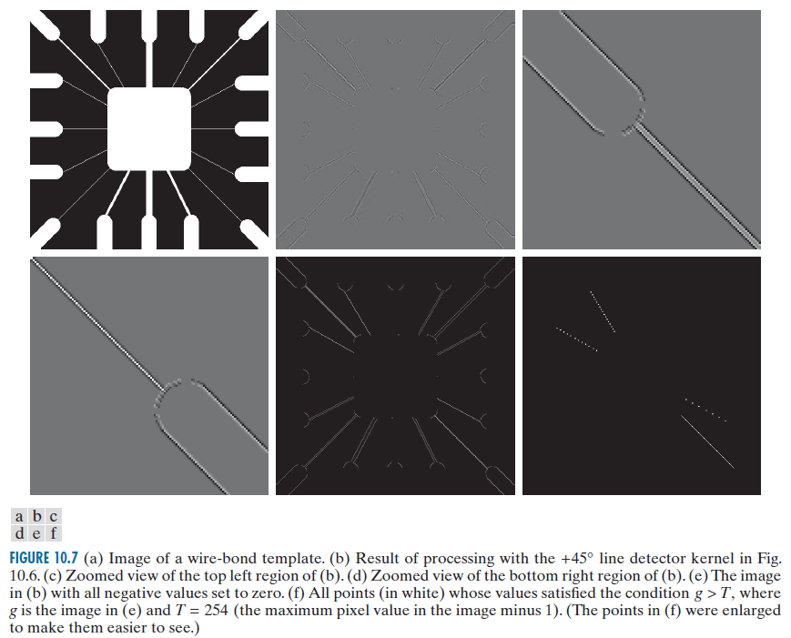
The image is filtered with the four masks and let R1, R2, R3, and R4 denote the responses of the four masks respectively at a point in an image.
If |R1| > |Rj| for j=2,3,4 , then that point is said to be more likely associated with a horizontal line. Alternatively with the other directions .

Slide 16

Edge Models
Edge detection is the approach used most frequently for segmenting images based on abrupt(local) changes in intensity.
Edge models are classified according to their intensity profiles.
Step edge : intensity suddenly increases over the distance of one pixel
Ramp edge: intensity smoothly increases over some set of pixels.
Roof edge: intensity suddenly increases and decreases over some base pixels. If the base is 1 pixel wide, then the roof edge is a one-pixel thick line

Slide 17
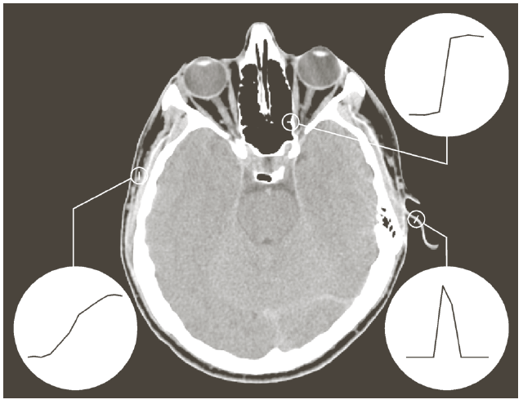
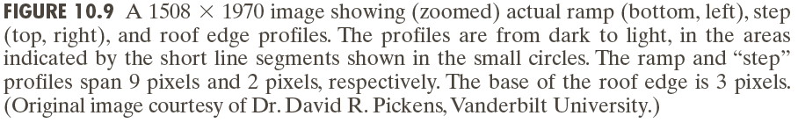

Slide 19
First and Second derivative in the presence of noise

Slide 20
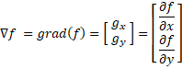
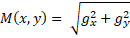
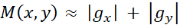
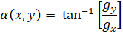
Basic Edge detection using First order derivative
The edge strength and direction at location (x,y) of an image, f(x,y), is the gradient , denoted by , and defined as the vector
The magnitude(length) of the vector is the rate of change in the direction of the vector
M(x,y) is the gradient image of the original image f(x,y)
The direction of the gradient vector is given by the angle, , measured with respect to x-axis.
α(x,y) is the gradient angle image of the original image f(x,y).

Slide 21
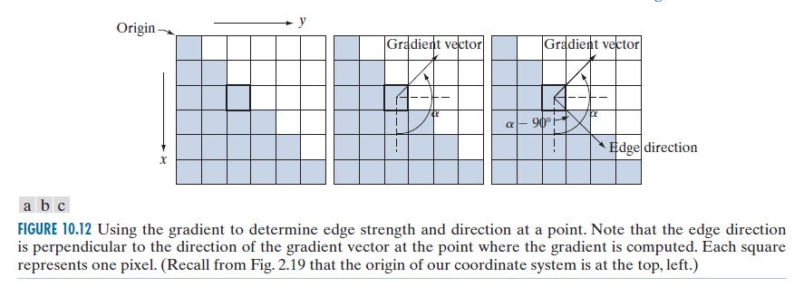
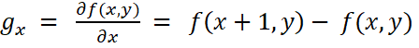
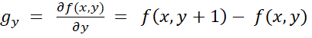
Gradient Operators
Obtaining gradient of an image requires computing the partial derivatives at every pixel location in the image.
These two equations can be implemented using 1-d masks as shown below

Slide 22
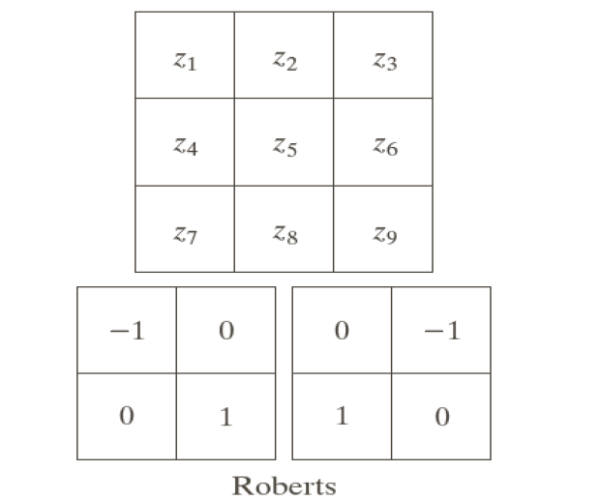
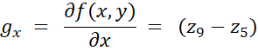
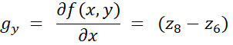
When diagonal edge direction is of interest, we need 2-d mask.
The Roberts cross gradient operators are used to detect diagonal edges.
The 2x2 masks are not so useful for computing edge direction.
The 3x3 masks of Prewitt and Sobel take into account the nature of the data on opposite sides of the center point.
Thus carry more information regarding direction of an edge.
A 3X3 region of an image and Robert mask used to detect diagonal edges

Slide 23
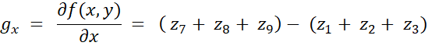
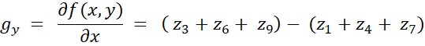
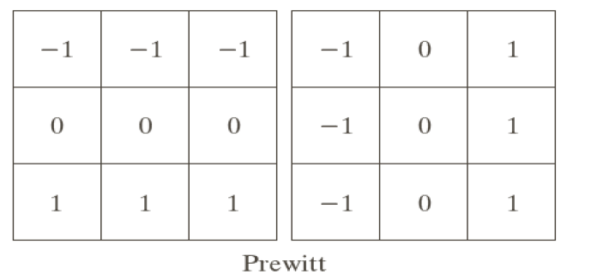
The simplest digital approximations to the partial derivatives using masks of 3X3 are given by
The masks from the above equations are called Prewitt operators used for detecting horizontal and vertical edges.

Slide 24
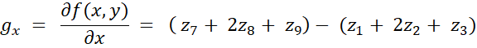
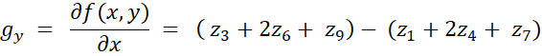
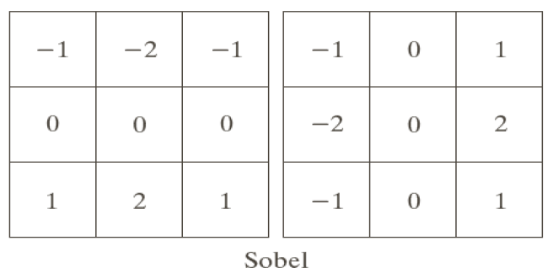
A slight variation of the preceding two equations uses a weight of 2 in the center coefficient:
The masks from the above equations are called Sobel operators used for detecting horizontal and vertical edges.

Slide 25
The following are the Prewitt and Sobel masks for detecting diagonal edges.

Slide 27
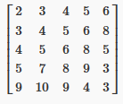
Compute the edge direction and magnitude at the centre pixel using the Prewitt edge detector. The direction of horizontal and vertical gradient of the detector is from left to right and from up to bottom, respectively

Slide 28
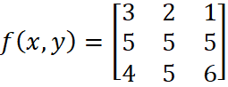
Compute the gradient image for the given hypothetical image using sobel masks for vertical and horizontal edge detection.
Hint: compute | gx | + | gy | for each pixel

Slide 30
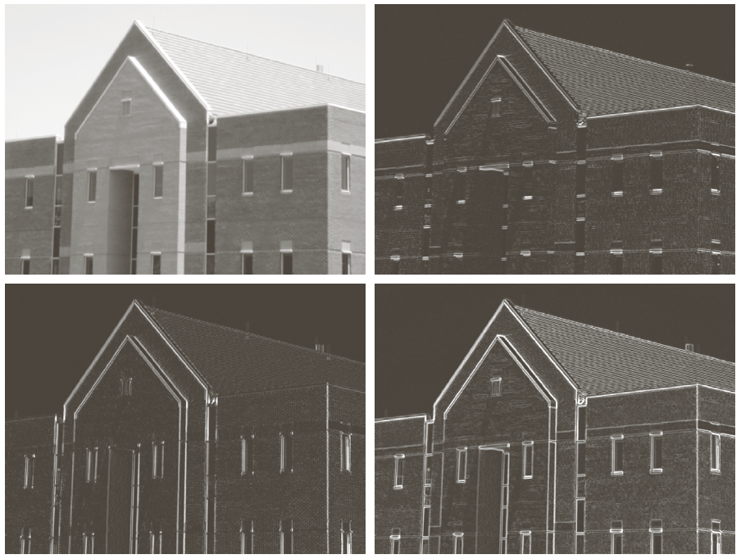
Smoothing the images prior to edge detection
Using smoothing prior to edge detection highlightes the principal edges

Slide 32
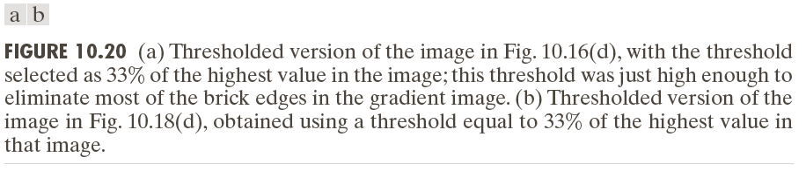
Combining the gradient with thresholding
Use thresholding to reduce number of broken edges.

Slide 33
Advanced edge detection methods
The basic edge detection methods do not consider the edge characteristics and noise content.
Where as the advanced edge detection methods consider those
The methods are
The Marr-Hildreth edge detector
Canny edge detector

Slide 34
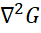
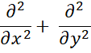
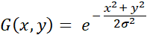
The Marr-Hildreth edge detector
Suggest that an operator used for edge detection should have two salient features
It should be a differential operator
It should be capable of being tuned to act at any desired scale
Being differential operator makes capable of computing digital approximations of the first and second order derivative.
Being tuned makes use of large operators to detect blurry edges and small operators to detect sharply focused fine detail.
According to Marr-Hildreth the most satisfactory operator fulfilling these conditions is the filter .
Where is the Laplacian operator( )and G is the 2-D Gaussian function with standard deviation σ

Slide 35
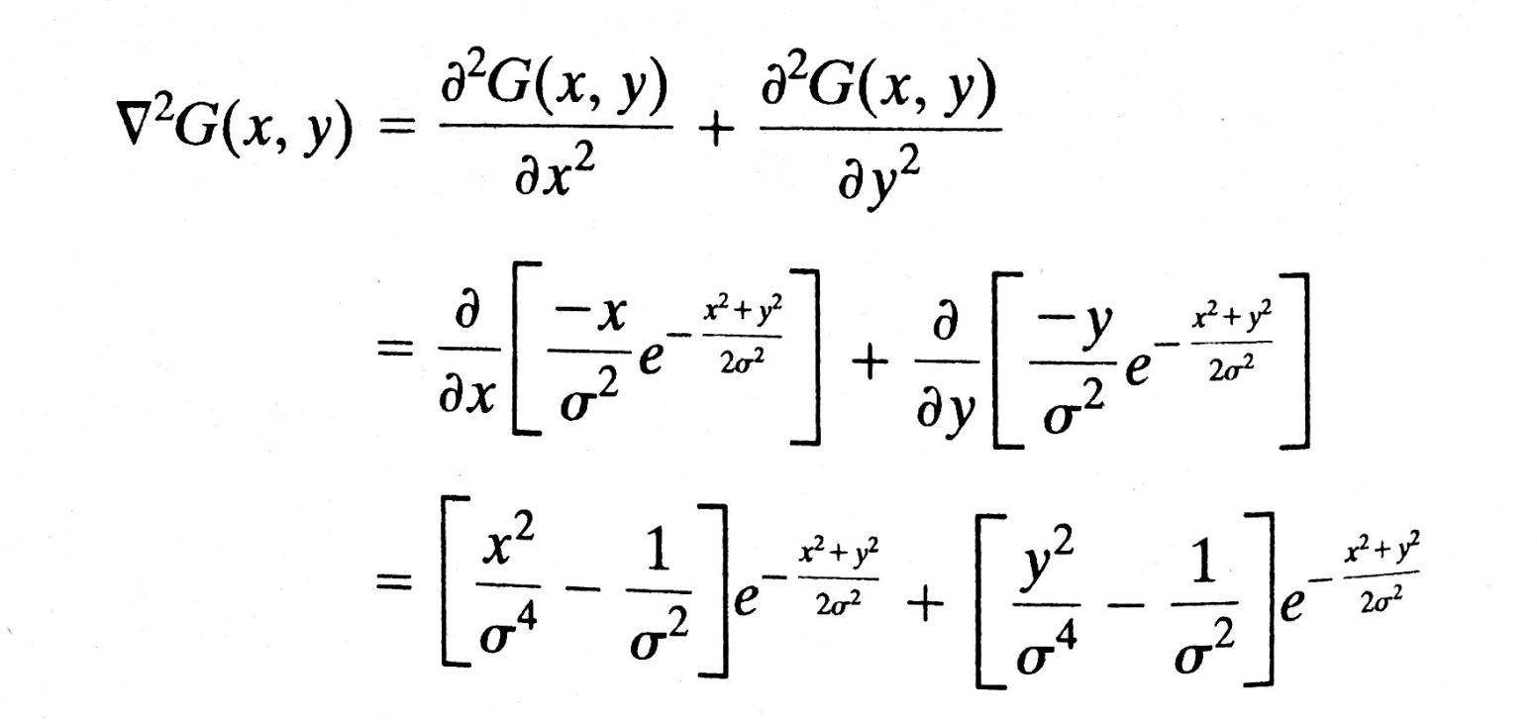
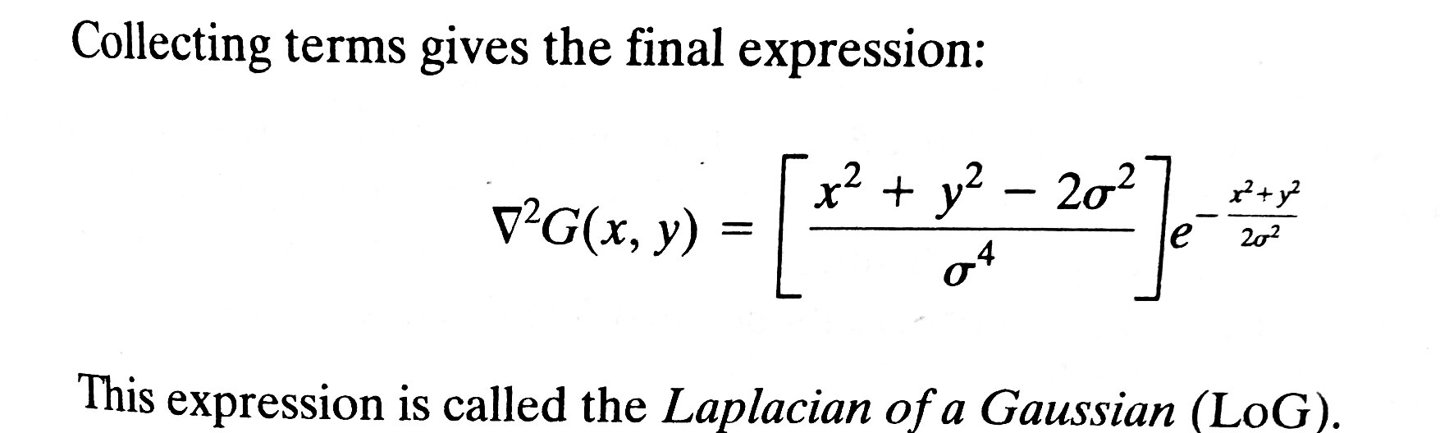

Slide 36
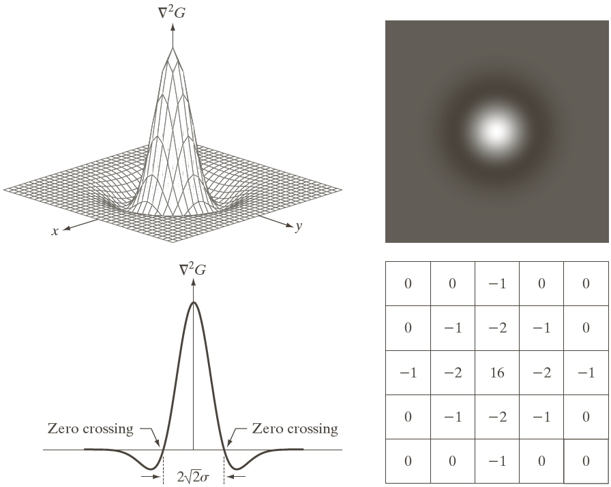
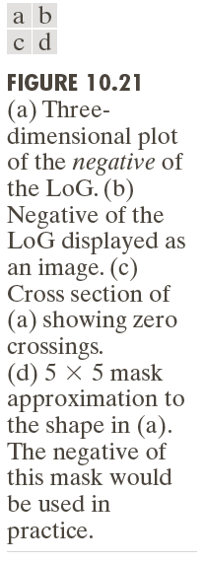

Slide 37
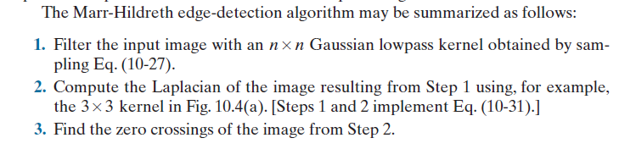

Slide 38
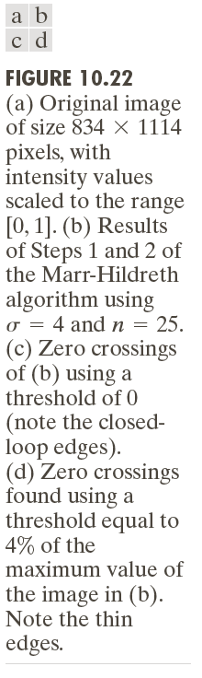

Slide 39
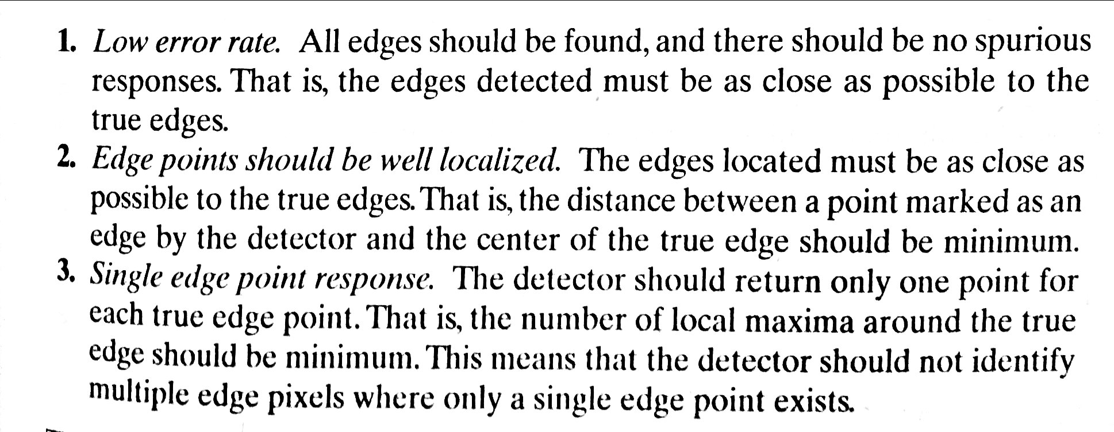
Canny edge Detection
Superior to the edge detectors discussed thus for.
Canny’s approach is based on three objectives:

Slide 40
The basic steps in Canny edge detection algorithm
Smooth the input image with a Guassian filter
Compute the gradient magnitude and angle images
Apply nonmaxima suppression to the gradient magnitude image
Use double thresholding and connectivity analysis to detect and link edges.

Slide 41
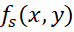

Step1: Smooth the input image with a Gaussian filter
Let f(x,y) denote input image and G(x,y) denote Gaussian function
We form a smoothed image, , by convolving G and f :

Slide 42


Step2: Compute the gradient magnitude and angle images
The gradient image
The angle image
with and

Slide 43
Step3:Apply nonmaxima suppression to the gradient magnitude image
Let d1, d2, d3, d4 , denote the four basic edge directions for a 3x3 region : horizontal, -45 degrees, vertical , and +45 degrees as shown in below figure

Slide 44

The following nonmaxima suppression scheme is applied for 3x3 region centered at every point (x,y) in α(x,y)
Find the direction d that is closest to α(x,y)
If the value of M(x,y) is less than atleast one of its two neighbors along d , let g_{N}(x,y) = 0 (supression); otherwise, let g_{N}(x,y) = M(x,y)

Slide 45

Step4: Use double thresholding and connectivity analysis to detect and link edges.
The Non-zero pixels in g_{NH}(x,y) are strong edge pixels
The Non-zero pixels in g_{NL}(x,y) are weak edge pixels

Slide 46

Connectivity analysis

Slide 47


Slide 49


Thresholding
The intensity histograms of an image are grouped into two dominant modes( background pixels and object pixels).
The obvious way to extract the objects from the background is to select threshold, T , that separates these modes.
Any point (x,y) in the image at which f(x,y) > T is called an object point; otherwise the point is called a background point.
The segmented image g(x,y) is given as
g(x,y) = 1 if f(x,y) > T
= 0 if f(x,y) <= T

Slide 50
When T is constant applicable to over an entire image, then the process is called Global thresholding.
When T changes over an image, then the process is called variable thresholding.
If the value of T at any point (x,y) in an image depends on properties of a neighborhood of (x,y), then the variable thresholding is called local or regional thresholding.
If T depends on the spatial coordinates (x,y) themselves, then the variable thresholding is called dynamic or adaptive thresholding
Multiple thresholding classifies a point (x,y) as belonging to background if f(x,y) ≤ T1, to one object class if T1 < f(x,y) ≤ T2, and other object class if F(x,y) > T2.
Then the segmented image is given by
g(x,y) = a if f(x,y) > T2
= b if T1< f(x,y) ≤ T2
= c if f(x,y) ≤ T1

Slide 51
Role of noise
For figures (a) and (b) a threshold placed midway between the two peaks would do a nice job of segmenting this image.
For figure (c) the noise is high so there is no way to differentiate background and the object.

Slide 52

Role of illumination and reflectance

Slide 53

Basic Global Thresholding
An algorithm capable of estimating automatically the global threshold value for each image is required.
The following iterative algorithm can be used:

Slide 54
Basic Global Thresholding
This simple algorithm works well in situations where there is reasonably clear valley between the modes of the histogram related to objects and background.
Parameter ∆T is used to control the number of iterations.
The initial threshold must be chosen greater than the minimum and less than the maximum intensity level in the image.
The average intensity of the image is a good initial choice for T.

Slide 55

Application of the preceding algorithm resulted in the threshold T = 125.4 after three iterations, starting with T = m(the average image intensity), and using ∆T = 0.

Slide 56
Optimum Global Thresholding Using Otsu’s Method
Thresholding may be viewed as a statistical-decision theory problem whose objective is to minimize the average error incurred in assigning pixels to two or more groups.
This problem is known to have an elegant closed-form solution known as the Bayes decision rule.
The solution is based on only two parameters:
The probability density function (PDF) of the intensity levels of each class
The probability that each class occurs in a given application.
The Otsu’s method is optimum in the sense that it maximizes the between-class variance.
The basic idea is “ a threshold giving a best separation between the classes in terms of their intensity values would be the best( optimum) threshold”.

Slide 57


Otsu’s method

Slide 58


Slide 59


Slide 60


Slide 61


Slide 62


Slide 63


Slide 65

Using Image Smoothing to improve Global Thresholding

Slide 66
Image smoothing before global thresholding failed in case of below example.

Slide 67

Using Edges to Improve Global Thresholding

Slide 68

Multiple Thresholding

Slide 69


Slide 71
Variable Threshoding
The approach of variable thresholding is to subdivide an image into nonoverlapping rectangles and apply global thresholding on each rectangle.

Slide 72


Slide 74



Slide 76
Region Based Segmentation
Region Growing
Is a procedure that groups pixels or subregions into larger regions based on predefined criteria for growth.
Region Splitting and Merging
Is a procedure that subdivides an image initially in to a set of arbitrary disjoint regions and then merge and/or split the regions in an attempt to satisfy the conditions of segmentation.

Slide 77
Region Growing
The basic approach is to start with a set of seed points.
From these grow regions by appending to each seed those neighboring pixels that have predefined values similar to the seed.
Similarity criteria like gray level, texture, or color.
Selction of one or more seed points is based on the prior information available with nature of the problem.
If prior information is not available, the procedure is to compute at every pixel the same set of properties
Those pixels which have the same properties are grouped in to clusters or seed regions.
The pixels whose properties place them near the centroid of these clusters can be used as seeds.

Slide 78

Region Growing
Let f(x,y) denote an input image array, S(x,y) denote a seed array containing 1s at the locations of seed points and 0s elsewhere.
Let Q denote a predicate to be applied at each location (x,y).
Arrays f and S are assumed to be of same size.
A basic region-growing algorithm based on 8-connectivity may be stated as follows.

Slide 79


Example
The 99.9 percentile of intensity values in the image is 254.
So all the pixels having 254 intensity level are selected as seed points and the seed array is formed containing 1s at the locations of seed points and 0s elsewhere.
Find all connected components in the seed array and erode each connected component in to single seed point.
Next we have to specify the predicate Q.

Slide 80
The problems having multimodal histograms generally are best solved using region based approaches.

Slide 81

Region Splitting and Merging
Subdivide an image initially into a set of arbitrary, disjoint regions and then merge and/or split the regions in an attempt to satisfy the conditions of segmentation.
The following procedure summarizes the method

Slide 83


Consider the image patch given below. For a threshold <3, compute the Region Growing output for the seed point (1,2). Note that the indexing starts at (0,0)

